Slide 1
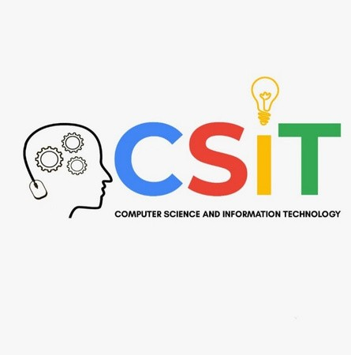

SUBJECT: EVALUATION OF INTERNSHIP TOPIC :- WINDOWS PASSWORD RESET
SESSION : 2022-23
SUBMITTED TO:
Prof. Nidhi Nigam
SUBMITTED BY:
Kanak Joshi

Slide 2
Content:
Steps to reset password
Technology used
Problem Statement
Problem Solution
Steps to reset password
Advantage and Disadvantage
Future Scope
Conclusion
References

Slide 3

Technology used:
Cyber Security :
Cyber security is currently one of the fastest growing and most in-demand industries in terms of employment opportunities. There are several reasons for this quicker- than-average growth across nearly every type of cyber security career. This includes the fact that cyber attacks are increasing at an unprecedented rate, and the malicious actors behind these infiltrations are continuously coming up with new attack strategies.
Cyber security is an ever-growing industry. It is projected to grow by 11% in 2023 and by 20% in 2025. This is a fast-paced career with a median salary of $81,000.

Slide 4
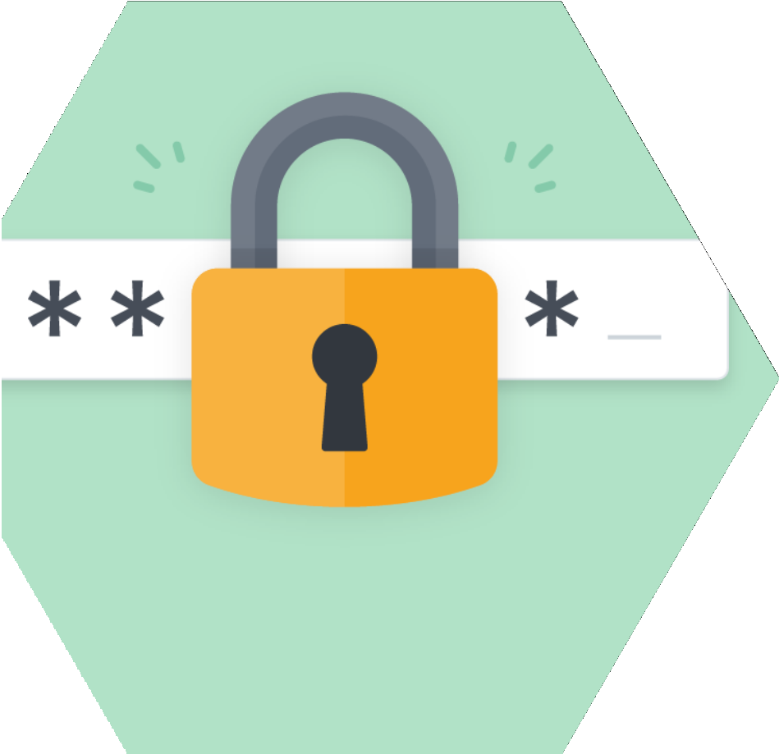
Problem statement:
People often face problem when they forgot their windows password . As their PC is locked Permanently as it may also contain some important documents which are worthy for the users . Now how to deal with it. So to deal with this problem we are required to change or Reset the windows pc password.
Objective:- Provide a solution for users to Reset their Windows Operating System Password without using disk.

Slide 5

Problem solution:
So here we have a solution for the problem discussed earlier
we can Reset it Easily by using some commands of the command of command prompt without the usage of any disk.
This is the most simplest method to Reset Password of windows.

Slide 6
Steps to Reset Password Of windows :-
Step 1: Prepare a Windows 10 setup disk
If you don’t have a reset disk, you can create one with media creation tool on another workable computer.
Step 2: Boot up password locked computer
Inset the reset disk to the locked computer and then power on your PC. When vendor logo appears, choose Boot Option Key repeatedly until the Boot Option Menu shows up. Find the suitable Boot Option Key for your computer and choose the USB drive to boot your computer.

Slide 7
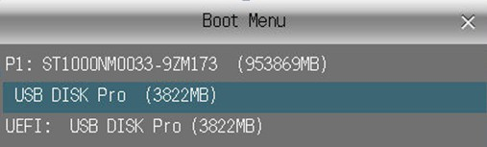
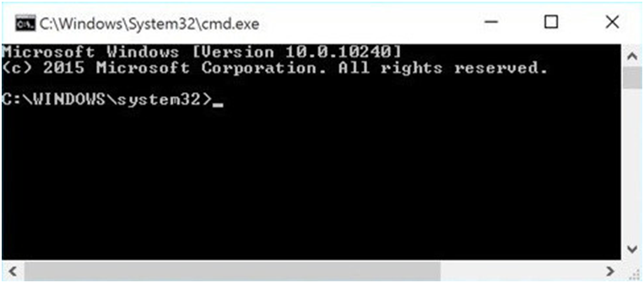
Step 3: Replace Utility Manager with Command Prompt
After the computer boots up from installation disk, press “Shift + F10” to bring up command prompt.

Slide 8
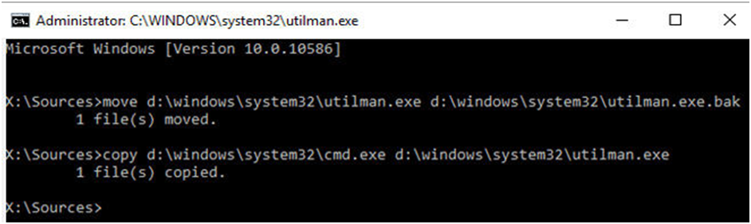
Now you can execute command below to replace utility manager with command prompt
move d:\windows\system32\utilman.exe d:\
copy d:\windows\system32\cmd.exe d:\windows\system32\utilman.exe
Take out the setup disk and restart computer after the commands are executed

Slide 9
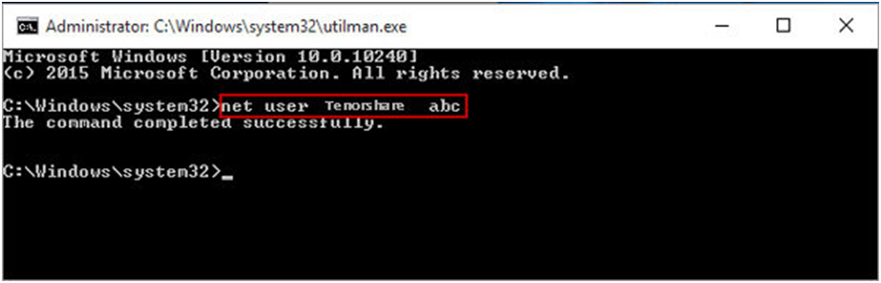
Step 4: Reset Windows 10 local admin password with command prompt
·When the login screen appears, click on the Ease of Access icon
on the lower-right corner, the command prompt will show up
·Type the following password reset command in the windows and hit Enter to set a new password
net user

Slide 10
Step 5: Restore Utility Manager
·Insert the reset disk into computer and click the Power icon to restart
·When computer boots up from the disk, press Shift +
F10 to open command prompt
·Type command "copy d:\utilman.exe d:\windows\system32\utilman.exe", press Enter, and then type "Yes" to restore Utility Manager.

Slide 11
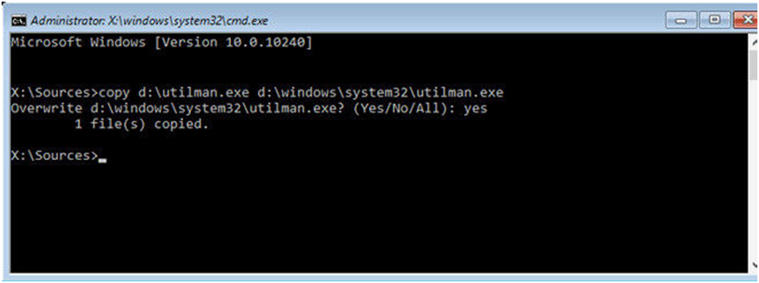
Step 6: Login Windows 10 with local admin account
Close the command prompt window and reboot Windows 10 computer. Login with the admin account you have reset password successfully.

Slide 12
If the user knows the correct commands then this type of interface can be much faster than any other type of interface.
Advantage of Command Line Interface
This type of interface needs much less memory (RAM) in order to use compared to other types of user interfaces.
This type of interface does not use as much CPU processing time as others.
A low resolution, cheaper monitor can be used with this type of interface.
A CLI does not require Windows to run.

Slide 13
For someone who has never used a CLI, it can be very confusing.
Commands have to be typed precisely. If there is a spelling error the command will fail.
If you mis-type an instruction, it is often necessary to start from scratch again.
There are a large number of commands which need to be learned - in the case of Unix it can be hundreds.
You can't just guess what the instruction might be and you can't just 'have a go'.
Disdvantage of Command
Line Interface

Slide 14
FUTURE SCOPE
Cyber Security – Growing Career Opportunity
The demand for cybersecurity is at an all-time high as the global business environment shifts to cloud data storage and online management. With increased internet exposure, commercial organisational data and the personal data of users are at a threat of being misused. This has increased the demand for people in cybersecurity that are familiar with and are skilled in cybersecurity. One of the main reasons for the industry’s quick growth is the ever-changing technological landscape, which necessitates hiring bright people with varying levels of knowledge.

Slide 15
Conclusion
As threats and protection measures continue to become more complex and sophisticated, it’s important for employers to find candidates with in- depth knowledge into cyber security and other highly relevant areas. In this way, while a bachelor’s degree may suffice for some types of cyber security careers, the most attractive candidates are those who hold master’s degrees.
Those interested in these or other types of cyber security careers can put
themselves on the path to employment by obtaining a high-level degree. The Online Cybersecurity, Master of Science program at the University of Nevada at Reno provides students with the skills, experience and expertise they need to pursue an array of exciting and high-compensating cyber security careers.

Slide 16
REFERENCES
https://www.teach-ict.com/
www.youtube.com
https://adamtheautomator.com/
https://mytekrescue.com/

Slide 17
THANK YOU

